Slide 1
Media production

Slide 2
Ideation work
Reflecting on the research conducted in the previous term regarding rising sea levels, the ideation process for designing and creating a 3D interactive experience involves synthesizing key learnings and leveraging them to develop an immersive and educational platform. The aim is to raise awareness about the impacts of rising sea levels and engage users in an interactive exploration of related themes.
Key Concepts and Themes
Impact on Coastal Communities: Explore the effects of rising sea levels on coastal communities, including displacement, infrastructure damage, and loss of livelihoods.
Environmental Consequences: Investigate the environmental consequences of rising sea levels, such as habitat destruction, loss of biodiversity, and increased frequency of natural disasters.
Mitigation and Adaptation Strategies: Highlight various mitigation and adaptation strategies employed to address the challenges posed by rising sea levels, including seawalls, mangrove restoration, and sustainable coastal development.
Climate Change Connection: Connect rising sea levels to broader issues of climate change, emphasizing the role of human activities in exacerbating the problem.
Interactive Experience Features:
Virtual Environment Creation: use Maya to design and develop 3D assets representing rising sea levels including planets like the sun, earth, and ice bergs to show the effects of melting ice bergs
Navigable Environment: Construct a navigable virtual environment where users can explore different scenarios and interact with elements such as sea level rise projections, flood simulations, and community resilience measures.
Interactive Elements: Incorporate interactive elements within the environment, allowing users to engage with informational pop-ups providing information on rising sea levels
Narrative Framework: Develop a narrative framework that guides users through the interactive experience, weaving together scientific information, personal stories, and multimedia content to create a compelling and immersive storytelling experience, embedded with sounds to make it more educational and fun and not so negative to make people want to change it.
User Engagement: such as conversations and buttons

Slide 3
Assets
Maya assets – I created multiple maya assets for my interactive world in unity. I decided beforehand what assets to create which fit my theme and I chose planet earth, the sun and an iceberg as these three assets will be needed in my world for the interactivity part and to make it make sense. As well as this I looked on unity assets before I started to see what they had that could fit my needs and these three were the main things I couldn’t find that I liked the look of or fit the aesthetic for my world.
Planet earth – I created a 3d oval and from there I hyper shaded the object with three different layers of materials which I found in maya textures you can download online. Once I hyper shaded them to the correct points and added lighting planet earth became realistic and fun.
Sun – I created again the same shape and from there added a fractural texture from there I just played around with the local attributes and made the perfect colour scheme for the sun that gave a shadow like fee and 3d fire to it.
Iceberg - with my ice berg I started off with just a long oval 3d shape and from there I moved around the faces and budged them in and made it have a textured outside to it and from there I just added a water texture from maya textures and made the opacity low.

Slide 4
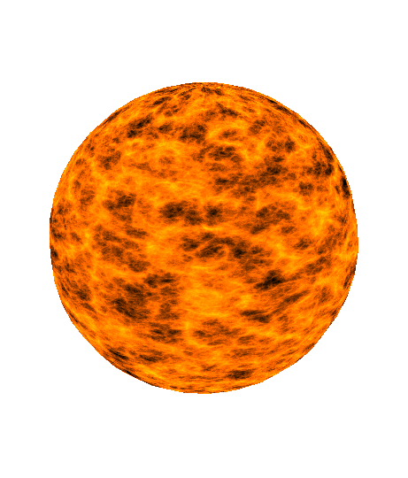
Sun asset
I crafted a sun asset in Maya by sculpting a cylinder and then infused it with dynamic texture through a fractal texture overlay atop Lambert shading. This texture animation showed the fiery essence of sunbeams. Yet, I wasn’t aware beforehand that integrating this into Unity not work due to the texture's complexity. So instead of this, in Unity, I seamlessly substituted the original texture with an online one to maintain visual consistency with my custom assets. You can observe the resemblance between the rendered assets and my creations here.

Slide 5
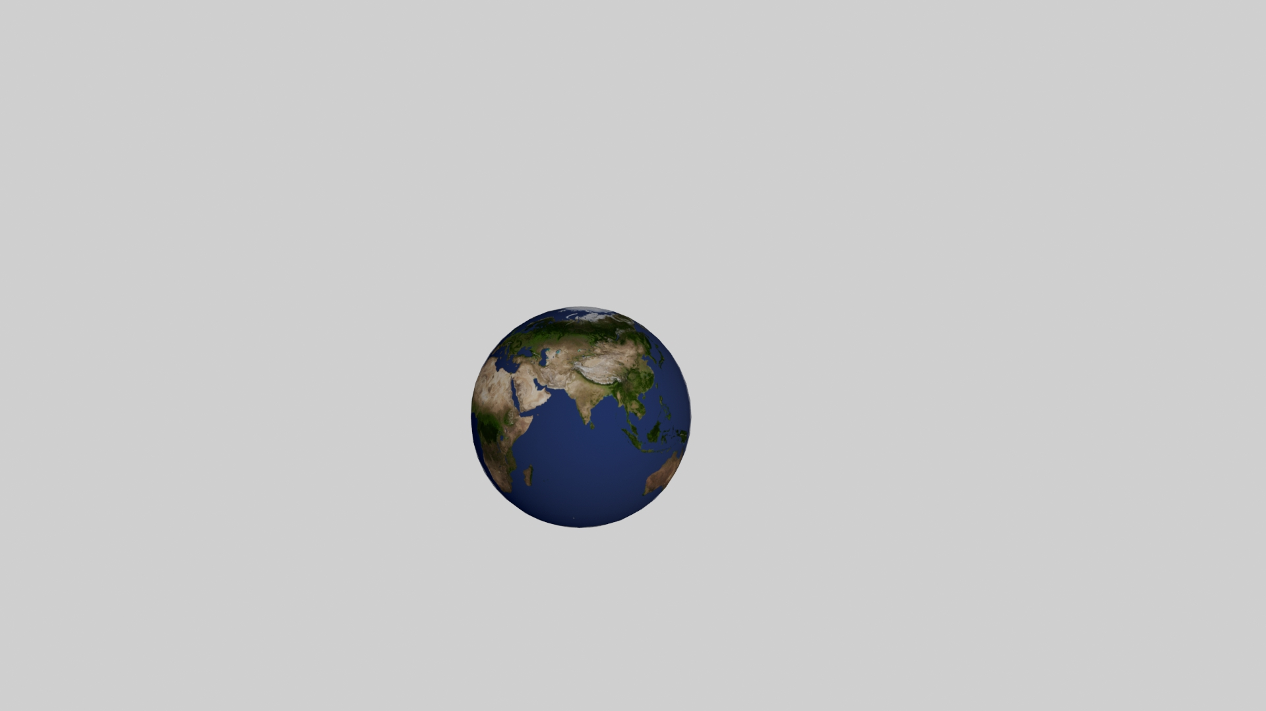
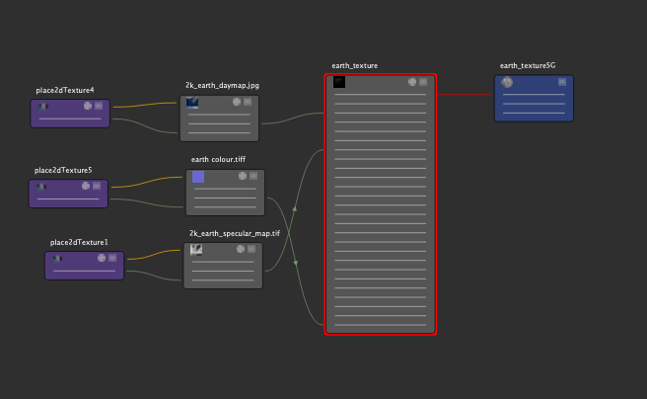
Earth asset
I created the same shape again but this time for the earth I hypershader the material and I got three existing materials from online to add into the hypersphere window adding it to different parts of the body.

Slide 6
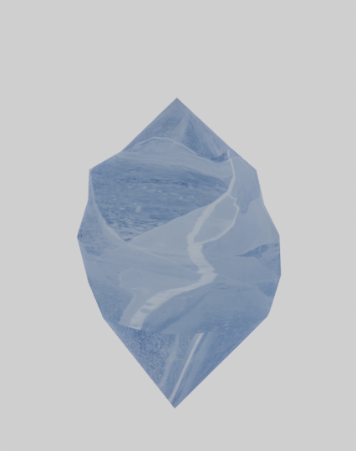
Iceberg asset
For this I created a cube and from there I manipulated the fcaes by transforming the position of the faces and edges to create points, edges, and irregular surfaces.

Slide 7
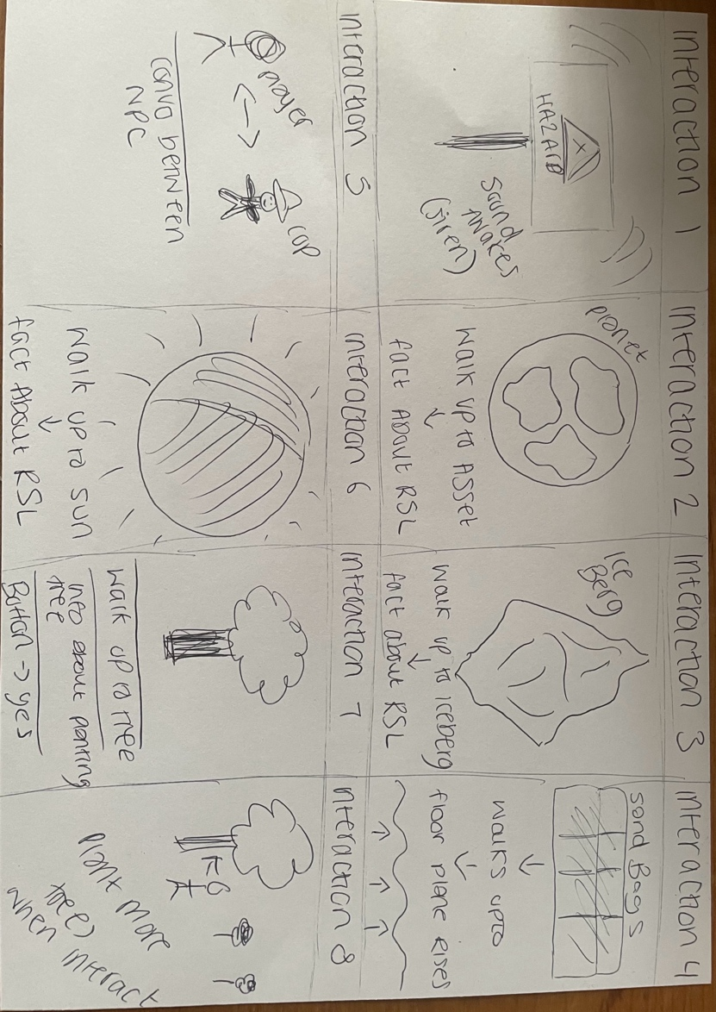
Story board

Slide 8
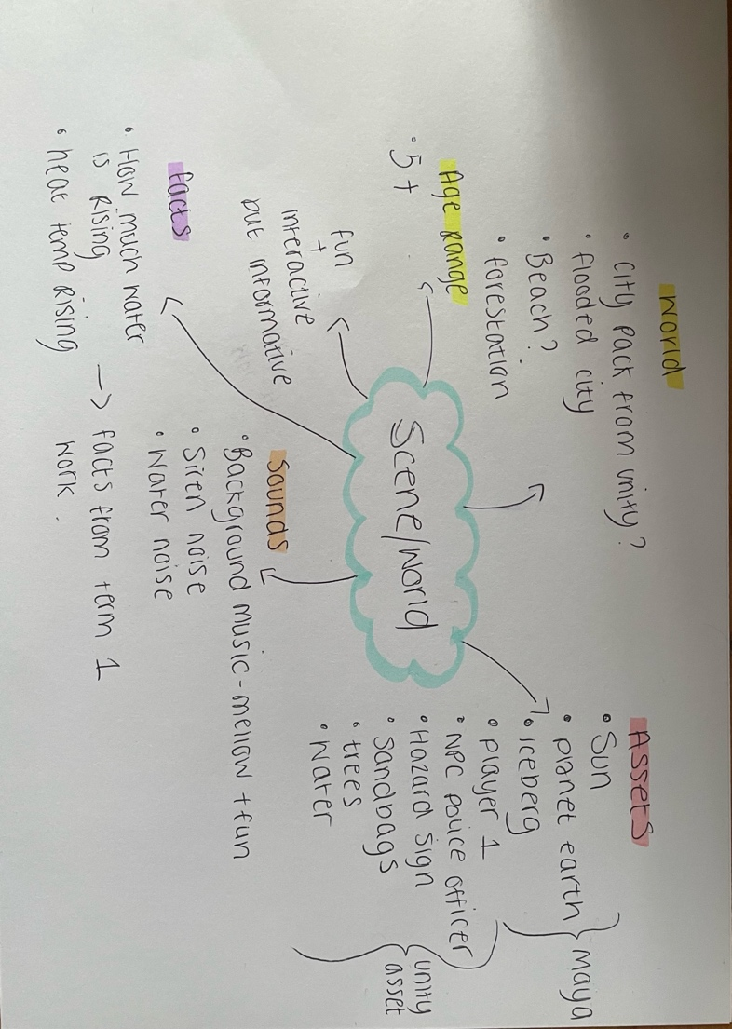
Mind map

Slide 9

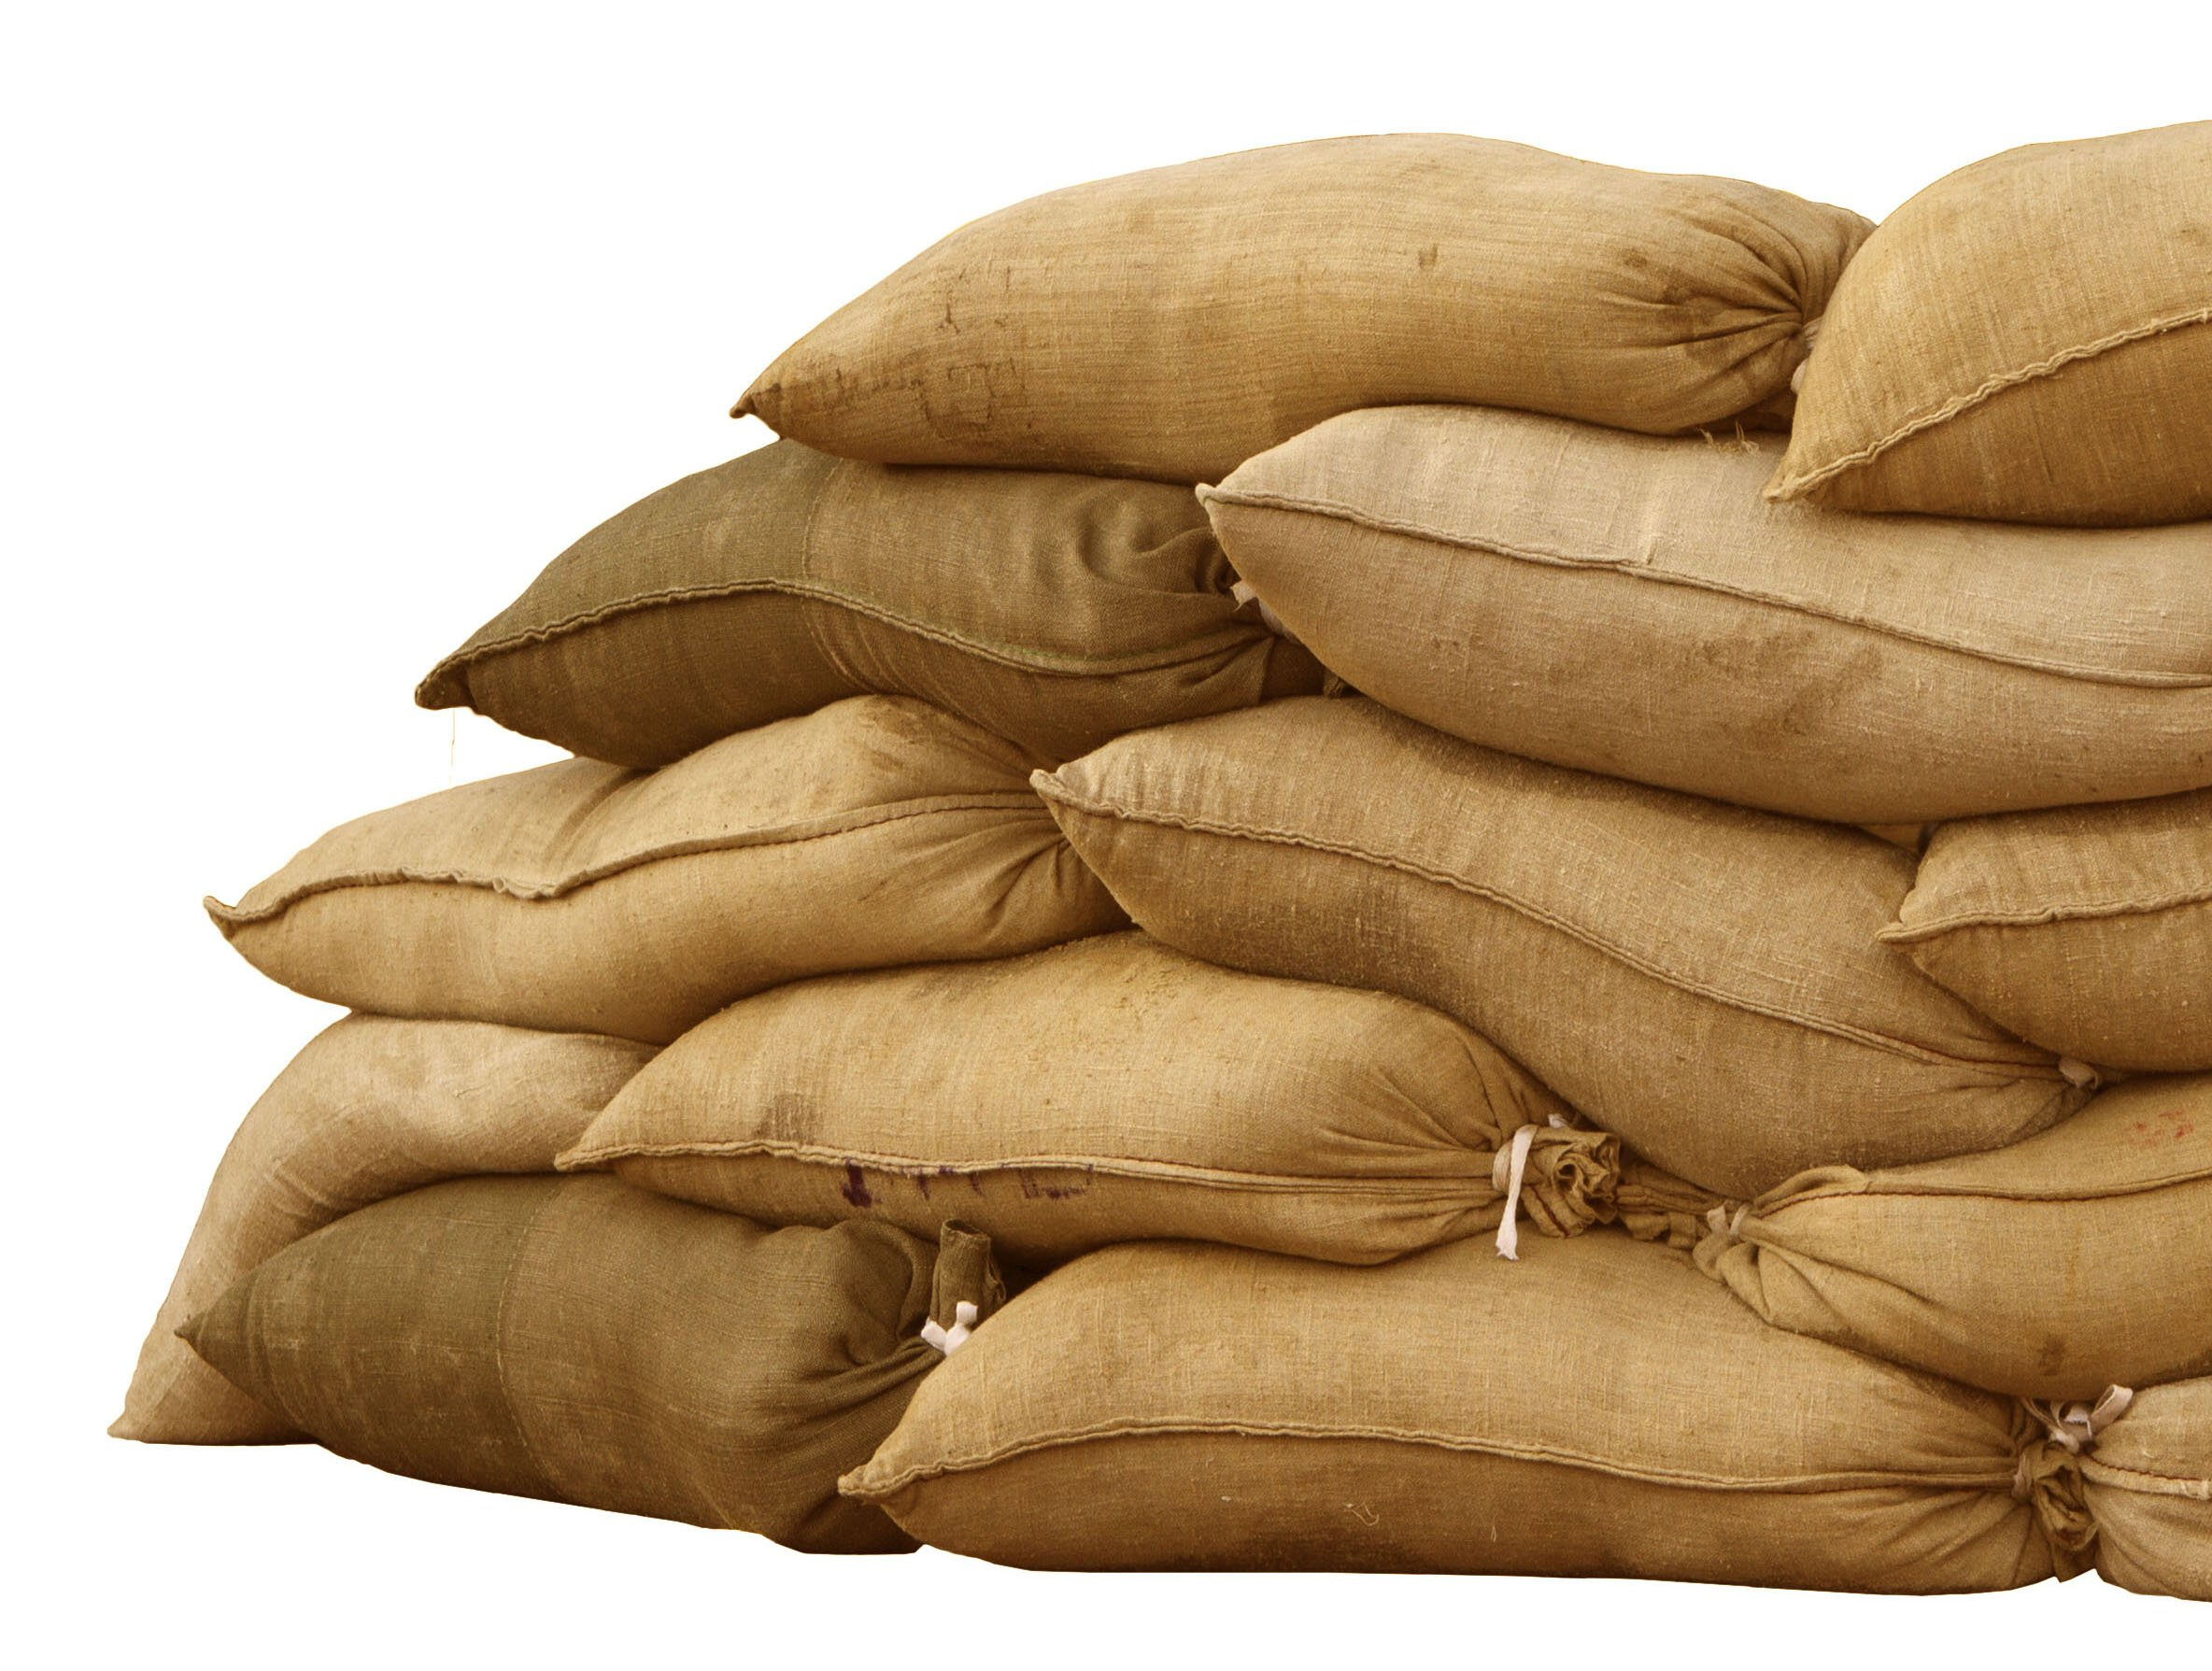
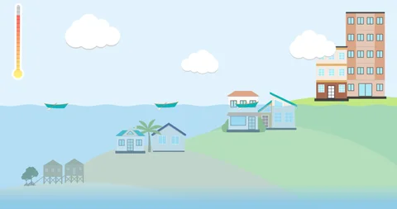
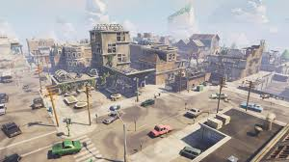
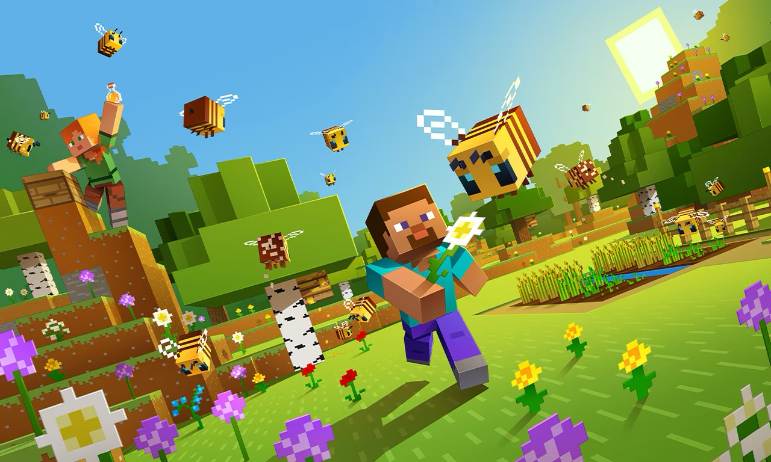
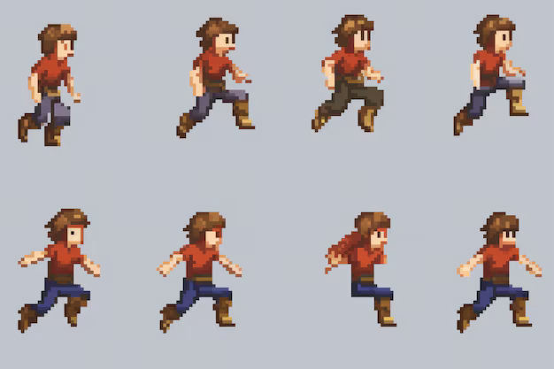
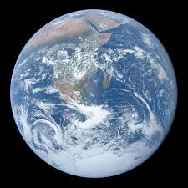

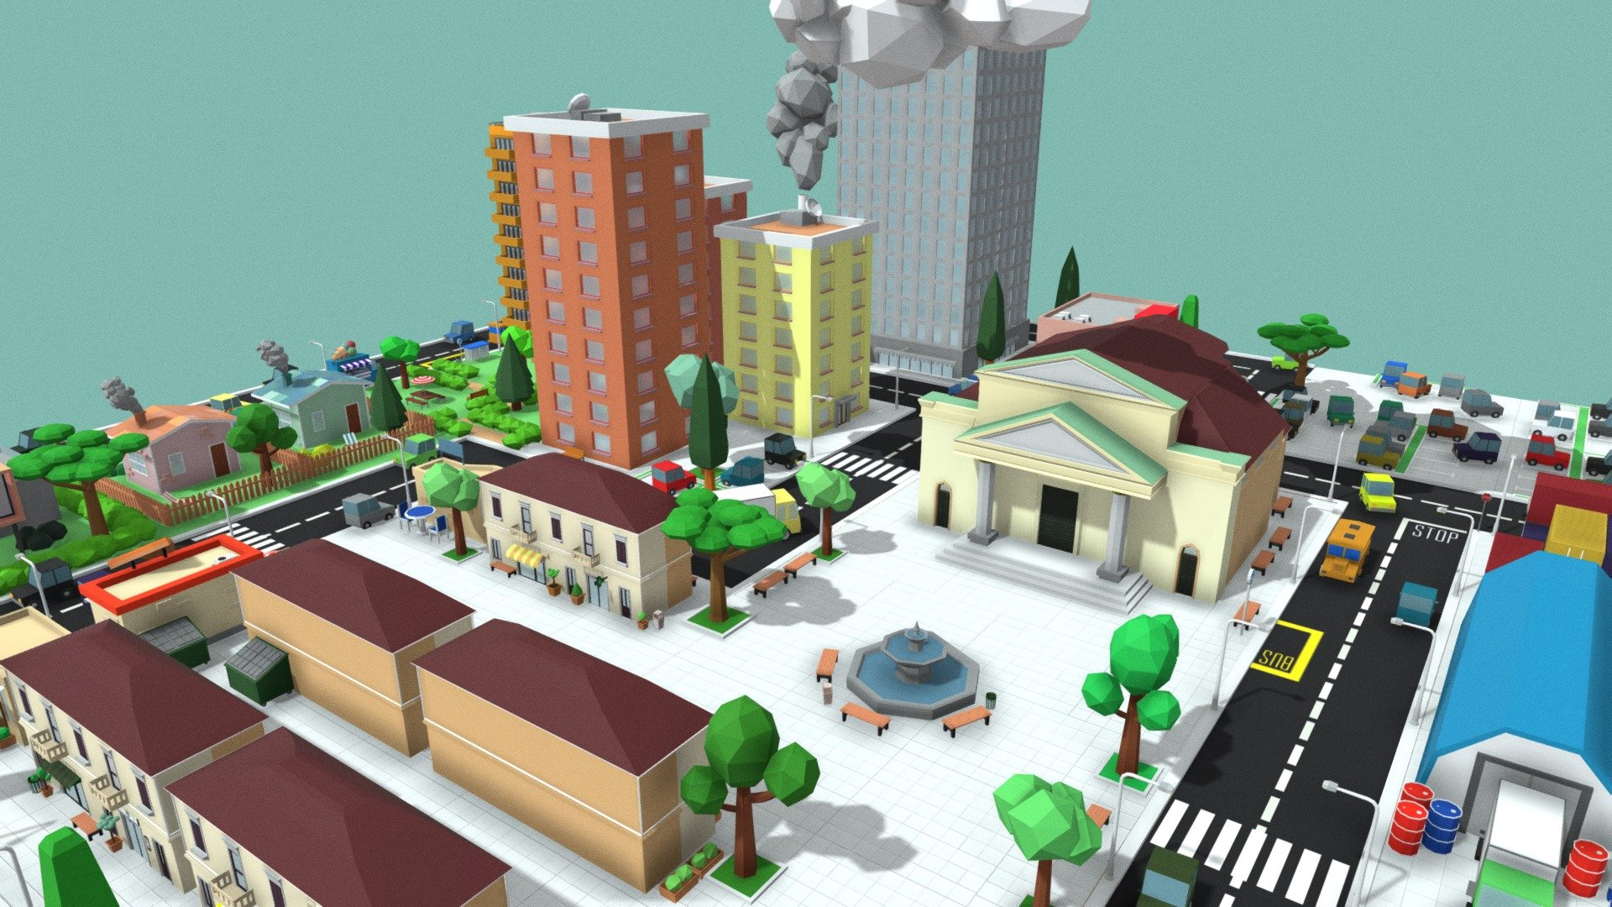

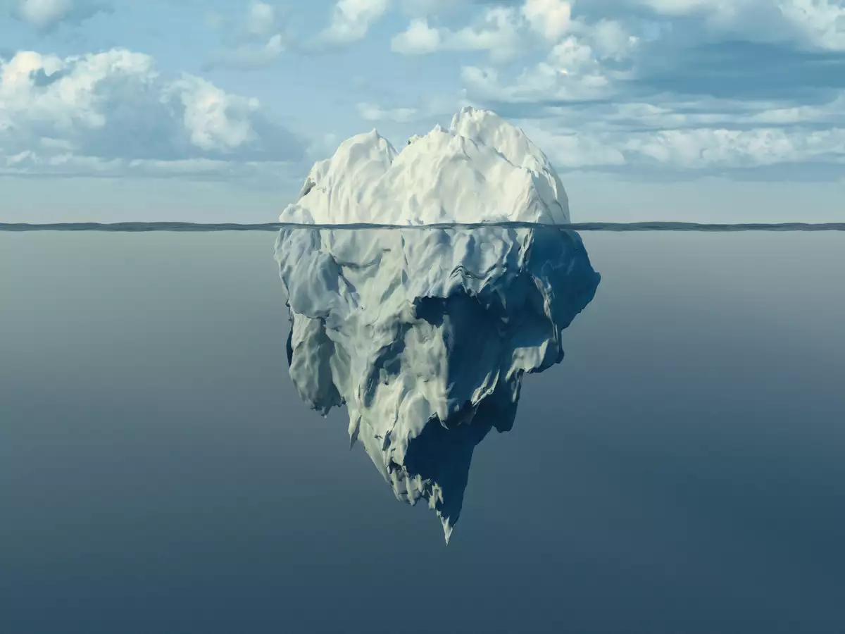
Moodboard

Slide 10
Unity assets used
Low poly city scene added into my own scene - https://assetstore.unity.com/packages/3d/environments/urban/city-package-107224
Animated sun skybox – https://assetstore.unity.com/packages/2d/textures-materials/sky/fantasy-skybox-free-18353
Waterplane and stylized ocean material - https://assetstore.unity.com/packages/2d/textures-materials/water/unlit-stylized-water-pack-142285
Character - https://assetstore.unity.com/packages/essentials/starter-assets-thirdperson-updates-in-new-charactercontroller-pa-196526
Hazard sign - https://assetstore.unity.com/packages/3d/props/exterior/3d-cartoon-road-warning-signs-260531
Sand bags - https://assetstore.unity.com/packages/3d/props/exterior/realistic-sandbags-95964
Police officer - https://assetstore.unity.com/packages/3d/characters/police-officer-proto-series-107256
Tree prefab -
Phone box - https://assetstore.unity.com/packages/3d/props/exterior/phone-booth-23178

Slide 11
Interactions inside my scene
walk up to hazard sign and siren noise starts and then stops when walk away from it
walk up to sandbags and the water levels flood the town and when u walk away it stops at the level it gets too when you walk away from the trigger
walk up to earth and gives you a fact about rising sea levels
walks up to iceberg and another fact about rising sea levels to do with melting ice
walk up to police officer press the key e and have a conversation with police officer about what’s going on in the city
walk up to sun and a fact about the heat and how it affects rising sea levels
walk up to first tree and a pop up explaining what trees do to help the world and then a button which gets you off it
walk up to another tree and press the key e and the player can plant more trees around the scene
Walks up to phone box and video comes up

Slide 12
audio
siren noise from sound snap
background music – sound snap

Slide 13
Evaluation
For my Media production assignment, I created an interactive environment focused on educating users about rising sea levels. my final product featured a cityscape environment with interactive elements such as NPC dialogues, tree planting mechanics, pop up information panels, sounds and more. I chose this interactive world for my subject as I think this shows in a fun way what is happening to the earth overtime by giving the user facts and statistics as well as having audio, conversations, and inputting more assets into the game yourself to show what they can do in real life to help.
I am satisfied with my final products and implementation of my assignment. The cityscape environment created using asset packs from the Unity Asset Store and custom models in Maya, I created myself, successfully conveyed the setting and provided a visually engaging backdrop for the interactive elements.
The use of NPC dialogues added depth to the experience, allowing users to engage in conversations and learn more about the effects of rising sea levels from virtual characters. The branching dialogue system provided flexibility and interactivity, enhancing the educational aspect of the project, this is also the same for the pop-up panels which gives you facts about that specific object the player walks up to.
The tree planting mechanics served as a hands-on learning experience, encouraging users to act and contribute to environmental sustainability within my world. By dynamically spawning trees near designated areas, users were able to visualize the positive impact of reforestation efforts in combating rising sea levels.
Audio visual cues, such as triggered sounds and animated elements representing flooding scenarios, effectively conveyed the urgency of addressing climate change and its impact on coastal cities. The siren sound added a sense of urgency and created a sense of worry for what could happen to the real world if we don’t act up on some things to help stop rising sea levels. As well as this I added a video player to my scene so when triggered my video from first term is played to speak more about the subject.
While the final products met the project objectives, there are some known issues and areas for improvement that I identified during the development process, I got some people to test my game on pc, laptop and windows and some users reported performance issues, particularly on lower end hardware configurations. Optimizing asset management, rendering pipelines, and script execution will be crucial for improving overall performance and ensuring a smooth user experience.
Feedback from playtesting highlighted areas for usability enhancements, such as adjusting audio levels, optimizing text size for readability, and refining gameplay mechanics for smoother interaction. Implementing these improvements will enhance the overall user experience and accessibility of the project.
While the cityscape environment was visually appealing, there is room for further visual polish and refinement. Adding more detail to the environment, adding lighting and shaders, and enhancing asset integration will elevate the overall visual fidelity of the project.
In conclusion, my assignment provided a valuable opportunity to explore the capabilities of the Unity engine and create an immersive educational experience on rising sea levels. The final products successfully achieved the project objectives and showcased the potential of interactive storytelling in virtual environments.
Moving forward, I plan to address the known issues and areas for improvement identified during the evaluation process. By iteratively refining and enhancing the project, I aim to create a compelling and impactful virtual experience that educates and inspires users to act on climate change.

Slide 14
References
Unity Asset Store: [https://assetstore.unity.com/](https://assetstore.unity.com/)
Autodesk Maya: [https://www.autodesk.com/products/maya/overview](https://www.autodesk.com/products/maya/overview)
sound snap -- https://www.soundsnap.com

